Slide 1
SOCIAL IMPACT TOUR
Literacy for Longevity
Ishita Raghuvanshi
Georgia Institute of Technology

Slide 2
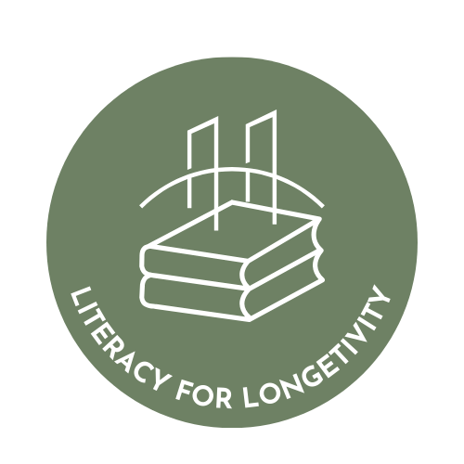
1. Overview of Your Social Impact Initiative:
Literacy for Longevity is a pamphlet based initiative for low income families and minority communities in the United States. The problem is specific and actionable: many people who can read still do not have clear step by step guidance to choose the right type of care for a health issue, understand insurance costs such as premiums deductibles copays and in network rules, and follow simple routines that prevent or manage chronic disease. As a result, care is delayed, avoidable bills occur, and conditions like diabetes and high blood pressure worsen. The goal is to produce a practical series of short pamphlets that translate complex healthcare and financial decisions into plain language checklists scripts and next step actions. Social impact is created by distributing materials through trusted community channels such as clinics community centers and local liaisons, translating where needed, and pairing distribution with brief walkthroughs so families can apply the information immediately to reduce financial harm and improve long term health outcomes.

Slide 3
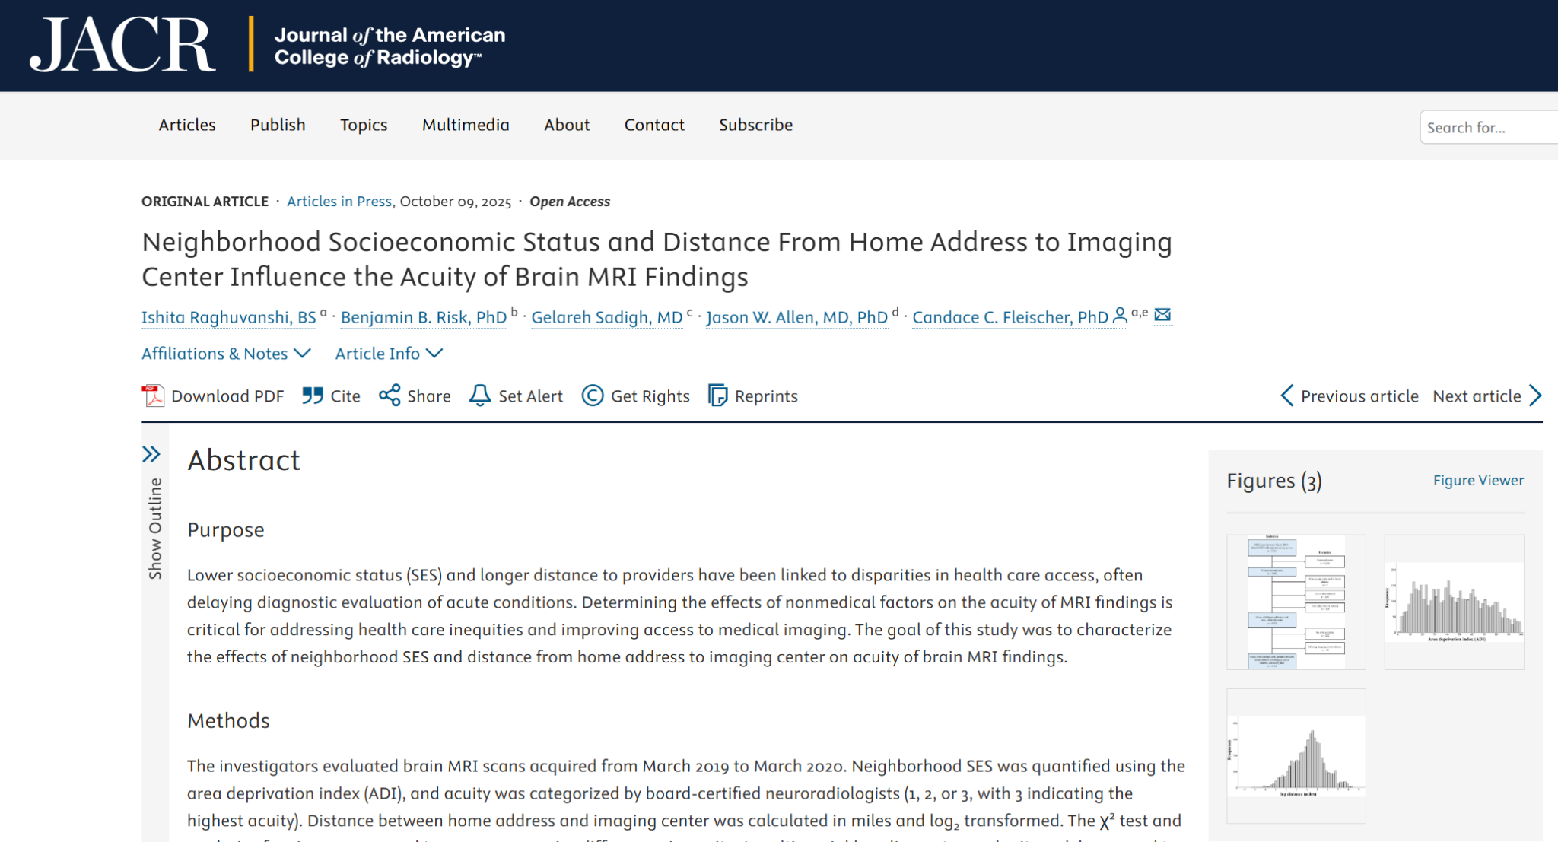
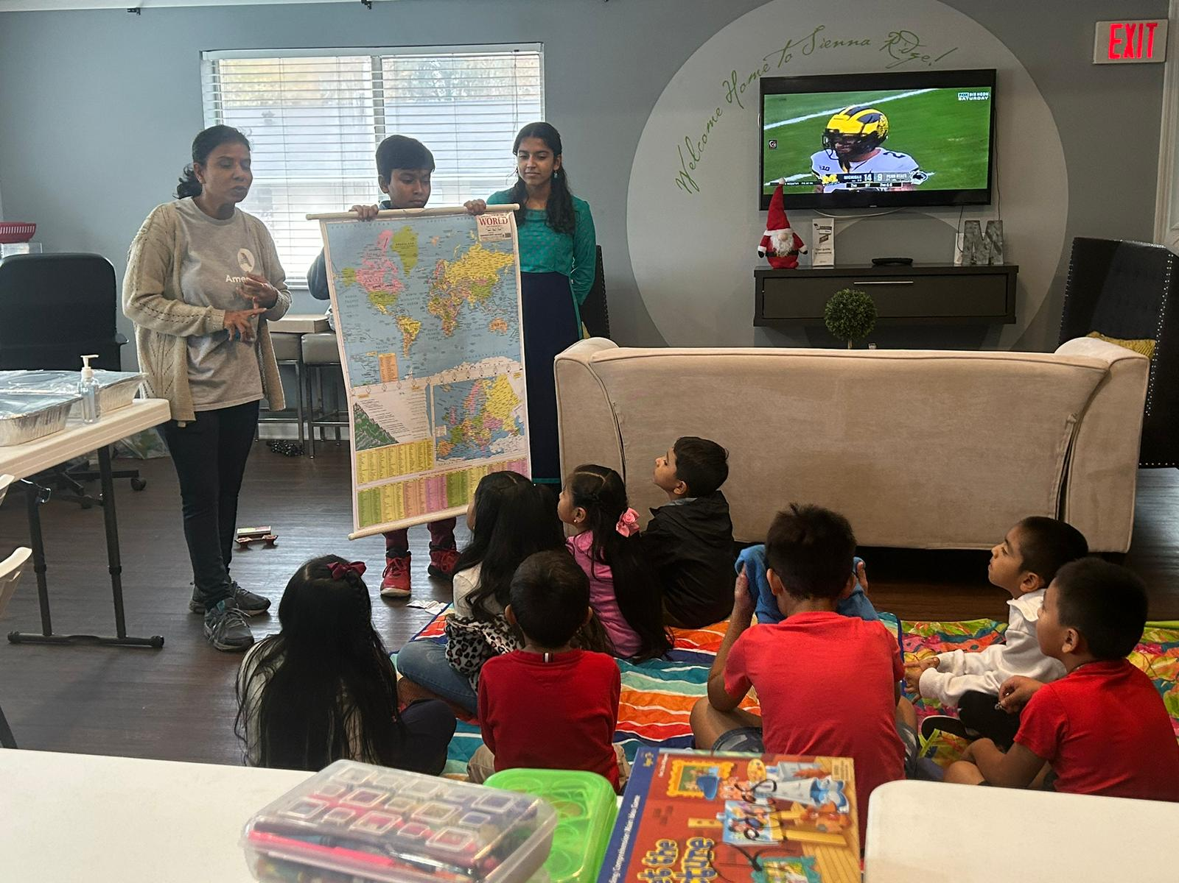
2. Why is this important to you?
In 2023, after my mom, an after school and summer program director for an AmeriCorps grant funded project, fell sick, I stepped in to help run an after school tutoring program serving students from low income Hispanic families in Metro Atlanta. While the program focused on academics, a consistent theme emerged in conversations with families. Many of the children were their parents translators for schools, forms, and everyday systems, and families shared that one of their biggest challenges beyond schoolwork was navigating healthcare in the United States. They described confusion around where to go for care, what services cost, and how insurance works, especially when they had limited educational backgrounds and limited English literacy. I saw a similar pattern with my research as well. A few months after my experiences at the camp, I started a project assessing the effects of nonmedical factors on acuity in brain MRI findings. Shockingly socioeconomic status and insurance were all factors that were tied to health outcomes.
Literacy for Longevity was created to respond to that need with simple, culturally respectful pamphlets that turn healthcare and cost decisions into clear, step by step actions. The key objectives are to help families understand insurance basics, choose the right type of care, ask the right questions before paying, and build practical routines for chronic disease prevention and management. The long term vision is a scalable, community distributed toolkit that reduces avoidable medical debt, increases timely preventive care, and improves chronic health outcomes. The change that is needed is a system where families are not forced to rely on their children to interpret high stakes healthcare decisions and where understandable guidance is available in trusted community spaces before a crisis happens.
My work in the Journal of the American College of Radiology on the effects of non-medical factors on health outcomes.
AmeriCorps Afterschool and summer enrichment program

Slide 4
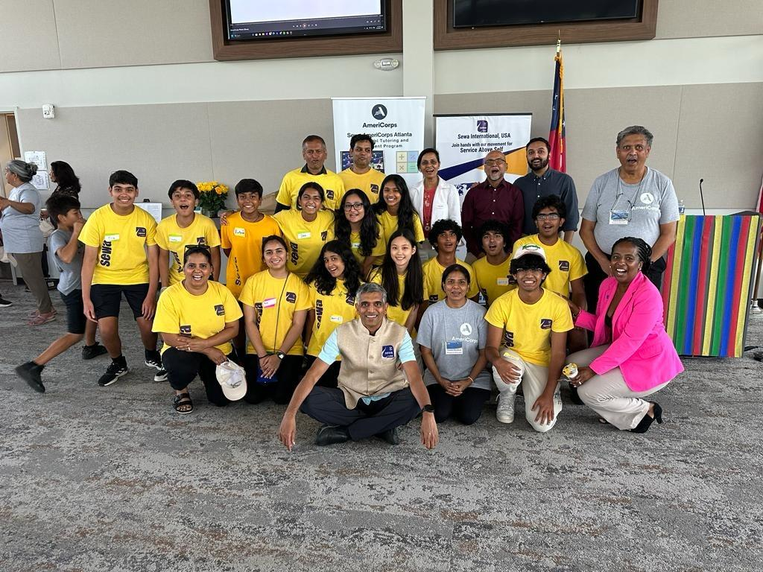
3. Project Activities & Impact:
Key actions focus on building accurate, usable materials and preparing for real world rollout. The work starts with converting common healthcare and cost decisions into short checklists and scripts written in plain language, then tightening them through rapid readability edits. To ensure accuracy, information is validated through expert outreach, including cold call and email interviews with professors and medical personnel, and revisions are made based on recurring themes such as reimbursement confusion and real behavior patterns that affect prevention and adherence. Accessibility is strengthened by working with a community liaison to translate select pamphlets and improve cultural fit. The distribution strategy is to pilot in one local Metro Atlanta community through trusted access points and collect feedback using short surveys and informal follow ups to guide the next version. Milestones so far include completing four pamphlets total, translating two of the four, conducting twelve expert interviews, and establishing a confirmed community contact for initial distribution.

Slide 5
4. Your Millennium Fellowship experience (Lessons learned):
The Millennium Fellowship taught three practical lessons. First, impact has to be designed around real constraints, so the approach shifted toward creating tools that people can use in minutes, testing clarity quickly, and revising based on what actually causes confusion. Second, credibility matters as much as creativity in health and finance, so expert review, careful wording, and avoiding oversimplification became non negotiable. Third, working solo requires systems, not motivation, so leadership became about setting clear weekly deliverables, building an outreach pipeline for interviews, and tracking progress even when response rates were unpredictable. The Fellowship strengthened a style of social impact work that prioritizes practical usefulness, ethical accuracy, and measurable progress, with partnerships and community trust treated as core outputs rather than afterthoughts.
Build something small enough to finish and specific enough to measure. Pick one clear problem, define a simple deliverable, and set weekly milestones so progress does not depend on motivation. Get feedback early from the people you are trying to serve, then rewrite based on what confuses them, not what sounds impressive. If your project touches health, finance, or legal topics, prioritize accuracy by recruiting quick expert reviewers and adding clear limits on what the project can and cannot advise. Treat outreach like a pipeline: send more messages than you think you need, follow up consistently

Slide 6
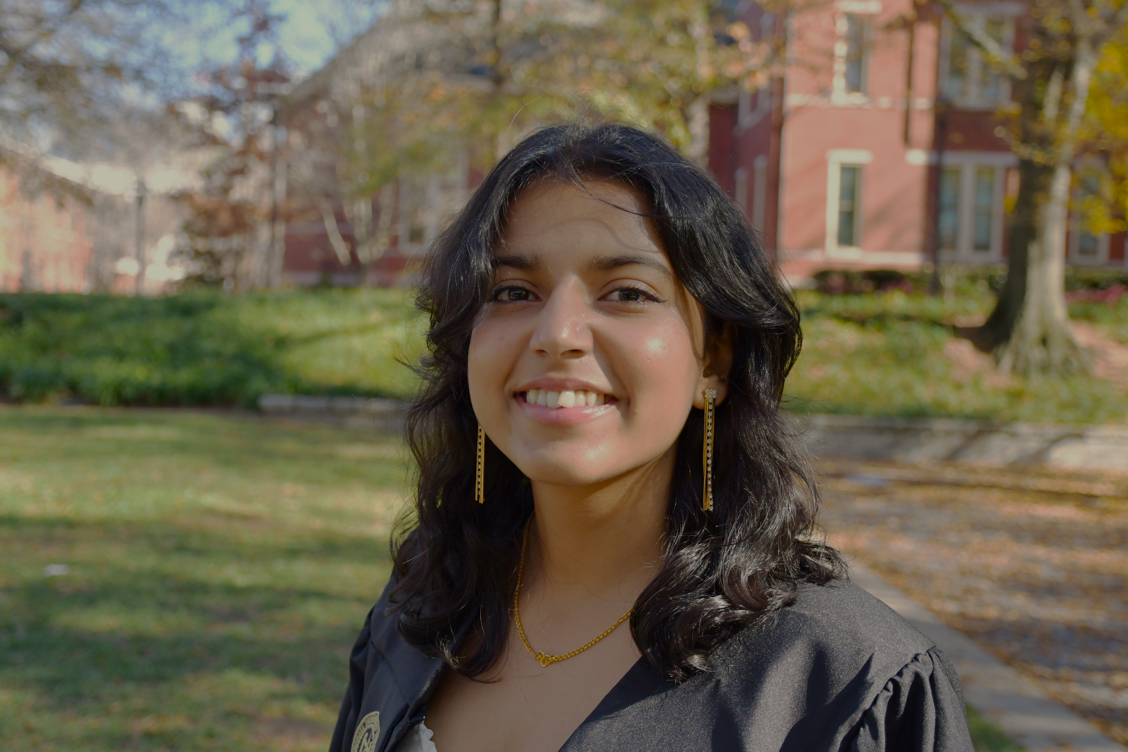
5. Call to Action:
Support is needed in three areas: distribution, translation, and expert review. Literacy for Longevity is creating short, step by step pamphlets that help low income families and minority communities in the United States navigate healthcare costs and insurance decisions and build practical routines for chronic disease prevention and management. The next phase is getting these materials into trusted community spaces and improving them through real feedback. Community clinics, pharmacies, schools, faith organizations, and nonprofits can partner to distribute pamphlets and host brief walkthroughs. Bilingual volunteers can help translate and localize content for Spanish and other high need languages. Medical and insurance professionals can review pamphlets for accuracy and clarity in 30 minutes. To join the movement, offer a distribution site, volunteer to translate or review, sponsor printing for a local rollout, or connect the project to a community organization that serves families who would benefit most. Please connect with me on LinkedIn and we can talk more! @ishitaraghuvanshi22

